Slide 1
Chapter 2 NEW VENTURE FINANCING CHOICES AND OPPORTUNITY VALUATION

Slide 2
Learning Objectives
Identify the financing sources available to new ventures and understand the factors that favor one source over another
Recognize basic attributes of the various financing sources and when each is likely to be available
Understand considerations that influence the financing choice, including organizational form and regulatory considerations
Recognize and use the common terminology of the market for new venture financing
Identify the key elements of deal structure (term sheets and investment agreements) and the basic functions they serve
Understand international differences in financing options

Slide 3
1.创业企业融资渠道
Notes:
监管者视角：preparing for the assessment of the viability and sustainability of their business models by regulators and investors in light of the on-going challenging environment;
and
管理层视角：
analysing their business models to ensure they are maximising shareholder value.

Slide 4
Considerations When Choosing Financing
How urgent is the financing need? 紧急程度-融资的速度（Match term with needs）
How large is it? 融资规模
Is it permanent or transitory? 长期还是临时需求
How does it relate to the cummulative need for financing?（未来现金流预期）
以上问题的答案取决于两个因素：
Stage of development 发展阶段；
Capital Intensity 资本密集程度：pros and cons；
Notes:
其他因素：Tax；
The value of outside advice ;
assessing the effect of fnancig choices;

Slide 5
Figure 2.1
Notes:
Figure 2.1 – Sources of New Venture Financing
Black shading indicates primary focus of investor type. Gray shading indicates secondary focus, or focus of a subset of investors.

Slide 6
Sources of New Venture Financing: Bootstrap Financing
Financing that does not depend on an investor’s assessment of the merits of the opportunity or on the value of the assets of the venture
May be from entrepreneur’s own resources or from friends and family
personal savings (90%)
credit card/personal loans (28%)
loans from family and friends (7%)
equity investment from family and friends (5%)
Notes:
Bootstrapping describes a situation in which an entrepreneur starts a company with little capital, relying on money other than outside investments. An individual is said to be bootstrapping when they attempt to found and build a company from personal finances or the operating revenues of the new company.
https://www.indeed.com/career-advice/career-development/what-is-bootstrap-financing

Slide 7
Sources of New Venture Financing: Angel Investors
Individual freelance investors usually interested in investing fairly small amounts ($25,000 - $500,000) in early-stage ventures
Willing to invest over long horizons
Evolved to a quasi-institutional form with angels acting as groups and may co-invest
Often bring significant industry experience and are interested in active involvement

Slide 8
Sources of New Venture Financing: Venture Capital
Venture Capital (VC) funds are organized as limited partnerships
Limited partners (LPs) provide most of the capital
General partner (GP) is responsible for managing the fund, including investment selection, working with entrepreneurs, and harvesting the investments（Exit）
Focused on equity investment in high-risk ventures with large potential return

Slide 9
Sources of New Venture Financing: Asset-Based Lenders（资产抵押借款）
Asset-based lenders, or “secured lenders,” provide debt capital to businesses that have assets that can serve as collateral
rely on the ability to liquidate business assets for debt servicing if necessary (rather than cash flow)
estimated at $590 billion in 2008 in the United States

Slide 10
Sources of New Venture Financing: Venture Leasing
An entrepreneur who requires tangible assets can lease, rather than purchase them
Usually involves assets that are key to the operation of the venture
The lessor’s return may be tied to the financial performance of the venture
Tax advantages to leasing as compared to owning（lease payment vs depreciation deductability）

Slide 11
Sources of New Venture Financing: Corporate Venturing
Can be internally or externally managed
Internally managed venture investing
more likely to occur in firms that depend on innovation to sustain competitive advantage
attempts to keep good ideas from “escaping”
Externally managed venture investing
may seek only financial returns or strategic investments

Slide 12
Figure 2.4
Notes:
Figure 2.4 – Corporate VC Investment as a Percentage of Total VC Investment
The figure shows total new VC commitments by VC funds, including corporate funds. It also plots corporate VC as a percentage of total commitments.
Source: PricewaterhouseCoopers/National Venture Capital Association MoneyTree™ Report, Data: Thomson Reuters.

Slide 13
Sources of New Venture Financing: Government Programs
Many countries have established agencies to support small business formation and growth
The US Small Business Administration (SBA) funds entrepreneurship via
loan guarantee programs
Small Business Investment Companies (SBIC)
Small Business Innovation Research Program (SBIR)
Research grants – National Science Foundation, National Institutes of Health

Slide 14
Sources of New Venture Financing: Trade Credit
Trade credit, or vendor financing arises whenever a business makes a purchase from a supplier that offers payment terms
Terms are usually industry-specific
Largest source of external short-term financing for firms in the US
More important in emerging economies, where risk capital is often scarce

Slide 15
Sources of New Venture Financing: Factoring（保理）
A factor buys accounts receivable of the venture and manages the collection activities
Factoring comes in two basic types
with recourse
without recourse
Basic elements of a factoring transaction
advance: 70 to 90% of face value of receivables
reserve: a portion held back if with recourse
fees: 2 to 6% for handling, lending, and risk

Slide 16





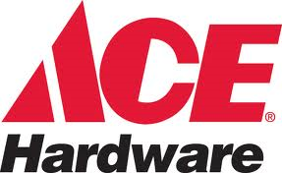
Sources of New Venture Financing: Franchising（LK Coffee）
Franchising can enable a business concept to grow rapidly by using capital from franchisees
Franchisor establishes a business format and offers franchising opportunities to prospective franchisees
Examples:

Slide 17
Sources of New Venture Financing: Mezzanine Capital （介于普通债和普通股之间的融资）
Capital raised after the firm has established a record of positive net income with revenues approaching $10 million or more
subordinated debt or preferred equity
a hybrid of senior debt and common equity “sweeteners”
often provided by some VC firms or other private equity funds

Slide 18
Sources of New Venture Financing: Debt
Pros
interest is tax deductible
debt is usually less expensive than equity
no loss of control
Cons
cash flow required for interest and principal payments
senior to equity and has contractual rights in the case of financial distress

Slide 19
Sources of New Venture Financing: Private Placements
Both equity and debt can be issued via “private placement”
Examples: VC and angel investments
Benefits
can be faster and less expensive than a public offering
limits disclosure of strategic information
facilitates monitoring

Slide 20
Sources of New Venture Financing: Initial Public Offering (IPO)
First sale of equity to public investors
IPOs provide a very small fraction of overall new venture funding
Provides exit for VCs and other investors in high-risk, high-growth ventures
Company raises capital by selling registered equity shares to the public via a formal offering process

Slide 21
Sources of New Venture Financing: Initial Public Offering (IPO)
Pros
establishes outside market for the venture’s shares
investor feedback on managerial decisions
can be used to effect acquisitions
employee stock incentives
large amounts of capital can be raised
Cons
relatively expensive
disclosure requirements
focus on short-term earnings
Readings: why do firms go public? 比较各种融资方式的优缺点，以及适用于初创企业的情况。

Slide 22
Sources of New Venture Financing: Direct Public Offering (定向增发）
SEC regulations provide “safe harbors”
Fall between private and public offering
Firm issues equity to small numbers of “sophisticated” investors
No formal public offering process
Shares may eventually become freely tradable
中国的定向增发

Slide 23
What’s Different about Financing Social Ventures?
Unable to issue equity
Financing through
structured debt
royalty-based financing or revenue rights
philanthropic funding
may allow investors to make tax-deductible contributions to “giving funds”
philanthropic angel investors
social VC funds

Slide 24
Considerations When Choosing Financing
Table 2.1
Notes:
Table 2.1– Common Organizational Forms in the US

Slide 25
Regulatory Considerations
All countries regulate public capital markets
Regulations limit access and affect financial disclosure
US federal securities laws
The Securities Act of 1933
regulates offerings and sale of securities
The Securities and Exchange Act of 1934
regulates aftermarket trading
State regulations: “blue sky” laws

Slide 26
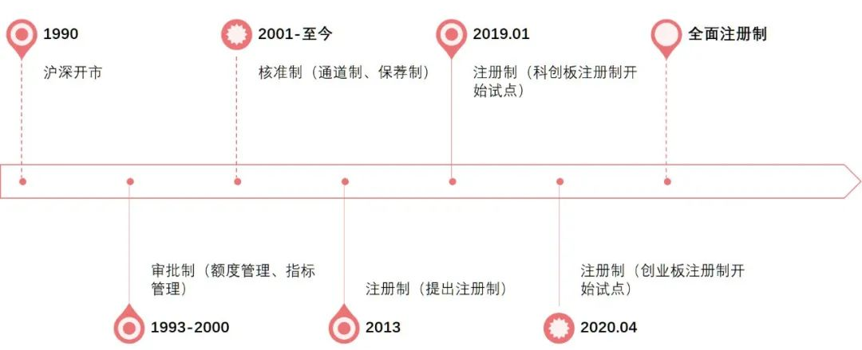
2.1 A股发行制度的变迁
Notes:
审批制下，新股定价管制主要采用的方式为固定市盈率和相对市盈率；核准制下，逐渐引入询价机制，主要包括两部分，初步询价和累计投标询价，初步询价是指发行人及其主承销商向询价对象进行询价，并根据询价对象的报价结果确定发行价格区间及相应的市盈率区间，再在累计投标询价环节，确定发行价格，自2014年3月以来新股定价以23倍市盈率为上限；注册制下，采取了市场化的IPO询价制度，将定价权下放给市场主体，不再行政管控发行价格，逐渐发挥市场的定价功能。
Hu, S., 2014. A New Year, but the Same Old Stock Market. New Century Magazine, January 29 Available at: http://english.caixin.com/2014-01-29/100635326.html.
Wei, L., 2015. China's response to stock rout exposes regulatory disarray. The Wall Street Journal Online Edition August 4, 2015.
Huyghebaert and Xu(2016) JAE;
Chen et al(2018) JCF;
Gao et al(2020) JCF;
Equally, the characteristics of the covered firms also matter, such as their intangible information (Higgins, 2013)

Slide 27
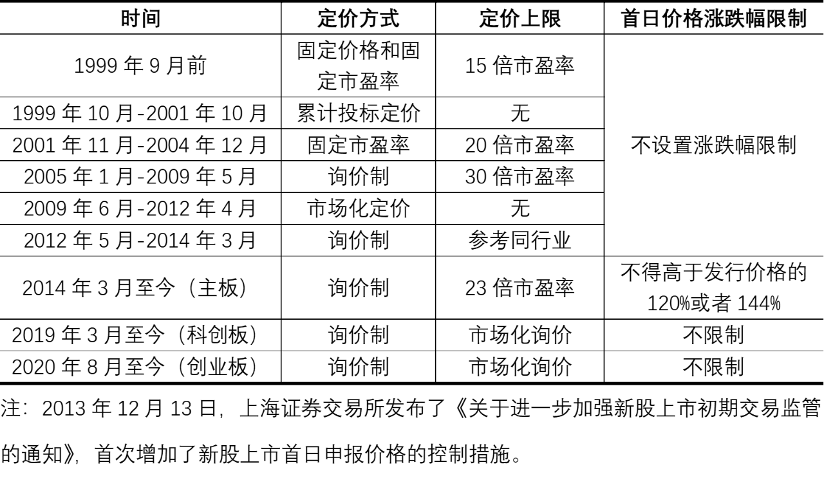
2.2 风险投资支持与注册制下IPO定价
Notes:
Before July of 1999, IPO pricing is set based on an online fixed mandatory Price/Earnings (P/E) ratio;
Beginning in July of 1999, the CSRC switched the online fixed price method to a regulated auction system. Under this method, underwriters first set an initial indicative
price range in consultation with the issuer and then submit this initial indicative price range to the CSRC for approval. After approval,
the underwriters can then begin their road shows to collect information from investors and to set the final issue price.
2 December of 2004, the CSRC abolished the regulated auction mechanism for IPOs and adopted a hybrid auction/fixed price
mechanism. In the first (offline) phase, the lead underwriter
conducts a road show, organizes bookbuilding, sets the offer price, and allocates the offer shares – all in consultation with the issuer.
During the road show, the lead underwriter provides an indicative price range and invites institutional investors to subscribe. Before April 2012, only institutional investors, including mutual funds, stock brokerage firms, issuance companies, trust firms, qualified foreign institutional investors (QFIIs) and financial firms,6 could submit bids and quantities for a maximum of 50% of the IPO shares. “dirty” multi-unit sealed bid auction (Jagannathan et al., 2015)
Chinese IPO allocation process is that underwriters do not have discretion in allocating oversubscribed IPOs. Prior to November of 2010, IPO share allocation in China followed a pro rata system in which allocations were proportional to bidding volume. After this date, the allocation rule remained the same on the Shanghai Stock Exchange, but switched to a lottery system on the Shenzhen Stock Exchange. On April 28, 2012, the CSRC removed the 3-month lockup period for offline institutional bidders.
November 1, 2010, the CSRC issued a report (Guiding Opinions on Further Reforming the System of Issue of New Shares) that mandates underwriters and IPO firms to disclose to the public institutional investors' bid prices and quantities from the offline auction process. 2014:After reopening in January 2014, a series of changes took place. First, an IPO firm is not allowed to raise proceeds
exceeding the amount specified in the prospectus. Further, the CSRC required IPO issuers to disclosure information consisting of the
following: expected proceeds, fees paid to intermediaries, and the number of shares to be issued. Following these changes, potential
investors can estimate more precisely the offer price through the following equation: Issue Price = [(Expected Proceeds to be
Raised + Fees Paid)/Number of Shares to be Offered].
市场化定价1：a major regulatory change took place on June 10, 2009: investment banks in Chinese domestic IPOs became—for the first time—fully responsible for fixing IPO offer prices, together with issuers. Before, IPO offer prices were largely set by the Chinese regulator, by applying a maximum P/E ratio to the issuer's earnings. As of June 10, 2009, this P/E ratio cap was abolished, and IPO lead managers henceforth set final offer prices after a book-building procedure among institutional investors.
June 10, 2009, with the publication of “The guiding advice on further reform of the IPO pricing method.” On that date, the CSRC announced that it would no longer interfere in the pricing of IPO stock; IPO offer prices would instead by determined by the IPO lead managers after a book-building exercise among institutional investors.

Slide 28
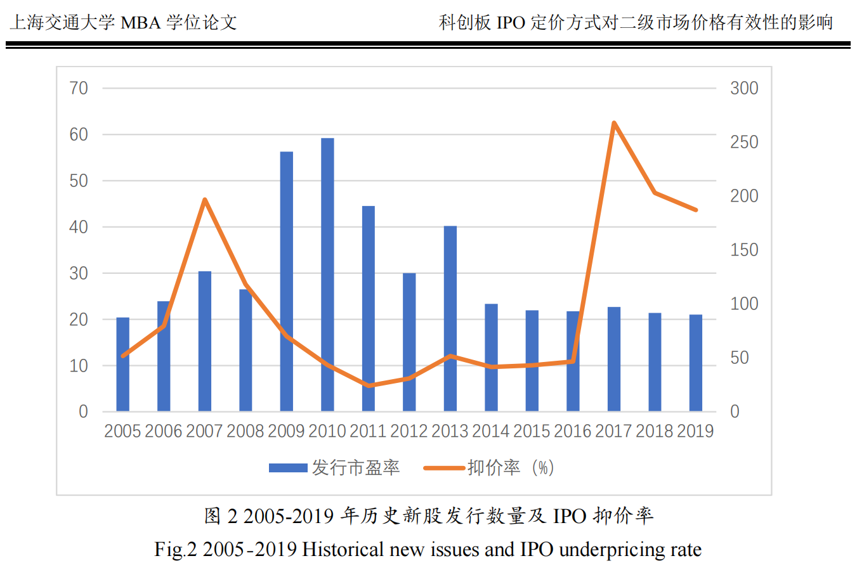
IPO制度与定价演变（叶舒，2019）
30 倍市盈率窗口指导阶段（2005 年 1 月-2009 年 5 月）
短暂的市场化定价阶段（2009 年 6 月-2012 年 4 月）
IPO 定价隐性管制和加速发行时期（2012 年 5 月-至今）：影子PE：30
Notes:
2014 年 1 月开始实行新股上市首日 44%涨跌幅限制制度，管理层的本意是为了避免新股爆炒，但是反而带动了市场的投机炒作情绪。绝大多数新股首日都能上涨 44%，然后随后的多个交易日继续封涨停。
假设２：IPO 发行中的价格因素、估值因素、经营情况、承销商因素、科创
因素和战投因素是 IPO 抑价率高低的影响因素。具体假设如下：
H2a：发行价格越高，IPO 抑价率越低。
H2c：经营情况越好，IPO 抑价率越低。
H2d：承销商总承销规模越大，自身声誉越高，IPO 抑价率越低。
H2e：IPO 公司科创属性越强，IPO 抑价率越高。
H2f：上市引入的战略投资比例越高，IPO 抑价率越低。

Slide 29
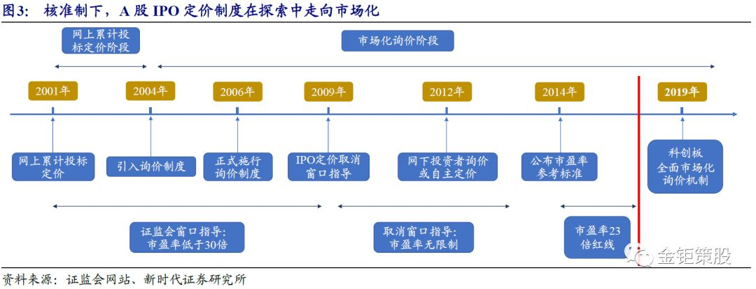
2005年保荐制、询价制
2009年6月
上市首日涨幅44%
前5日不限，之后涨幅20%
Notes:
https://finance.sina.com.cn/stock/stockzmt/2019-04-12/doc-ihvhiewr5379220.shtml
2009年6月，证监会曾发布《关于进一步改革和完善新股发行体制的指导意见》，取消“窗口指导”，推动IPO定价市场化，但随后IPO定价不断攀升
2005年，在保荐制和询价制
2014年1月，A股IPO重启，同时规定了上市首日的涨幅为44%。

Slide 30
2.商业模式与BP
Notes:
BM：BP的重要性下降，BM的重要性上升

Slide 31
What is Business Model？
“The logic of the firm, the way it operates, and how it creates and captures value for its stakeholders.”
“All it really meant was how you planned to make money”-
“Assumptions about what a company gets paid for” —Drucker’s（1994） “theory of the business.”
Notes:
Magretta-“Part one includes all the activities associated with making something: designing it, purchasing raw materials, manufacturing, and so on. Part two includes all the activities associated with selling something: finding and reaching customers, transacting a sale, distributing the product, or delivering the service. A new business model may turn on designing a new product for an unmet need or on a process innovation. That is it may be new in either end.”---“Why Business Models Matter,”
a different distribution system, perhaps (the iTunes store); or faster inventory turns (Kmart); or maybe a different manufacturing approach (steel minimills).
Casadesus-Masanell and Ricart (2008, 2010, 2011) and Casadesus-Masanell and Zhu (2010) operationalize this notion by decomposing business models into two fundamental elements: choices—such as policies, assets, and governance of policies and assets—and the consequences of these choices. The causal links between choices and consequences help explain the logic of the firm, how it creates and captures value for its stakeholders.
Ryanair—a company that competes through a generic low-cost strategy—has made business model choices, such as flying to secondary airports or the use of a standardized fleet of 737s, that have led to lower input prices.
Chesbrough and Rosenbloom (2002), for instance, a business model is a device that establishes a link between technological development and economic innovation.
Hedman and Kalling (2003) regard the notion as an integrative concept that connects the resource-based view and the industrial organization perspectives on strategy. And Amit and Zott (2001) propose a unifying definition “that captures the value creation from multiple sources.”
Magretta (2002), for example, defines it as a description of how the parts of a business fit together. Hedman and Kalling (2003) characterize the concept as a description of the key components of a business

Slide 32
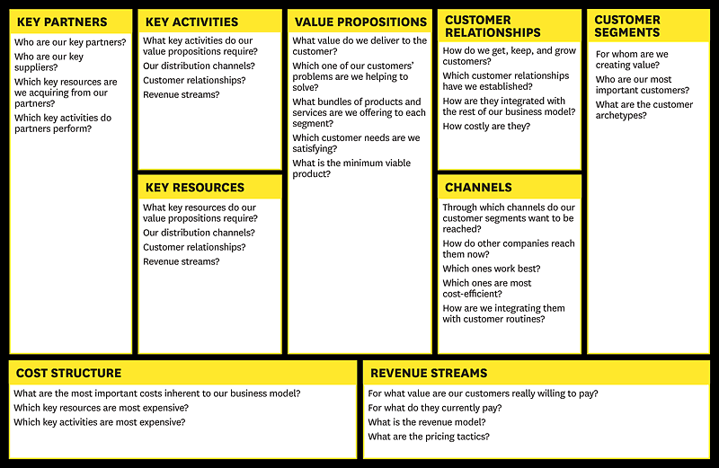
Business Model Canvas(商业模式画布）-Alex Osterwalder
小组活动：利用上述模型分析Wework的商业模式（阅读材料）
Notes:
“as the competitive, one-stop shopping center for the entire family where customer satisfaction is always guaranteed.”
Casadesus-Masanell and Ricart (2010). According to this view, a business model is composed of two types of
elements: choices made by the management and the consequences of these choices. There are
three types of choices: policies, assets, and governance of assets and policies.
There are three types of choices: policies, assets, and governance of assets and policies.
Policy choices refer to courses of action that the firm adopts for all aspects of its operation.
Asset choices refer to decisions about tangible resources.
Governance choices refer to the structure of contractual arrangements that confer decision rights over policies or assets.
This second element can also be found in the dynamic RCOV framework developed by Lecocq, Demil, and Warnier (2006).
These authors identify three different components to every business model: resources and
competencies (RC), internal and external organization (O), and a value proposition (V). These
components are linked creating virtuous cycles.

Slide 33
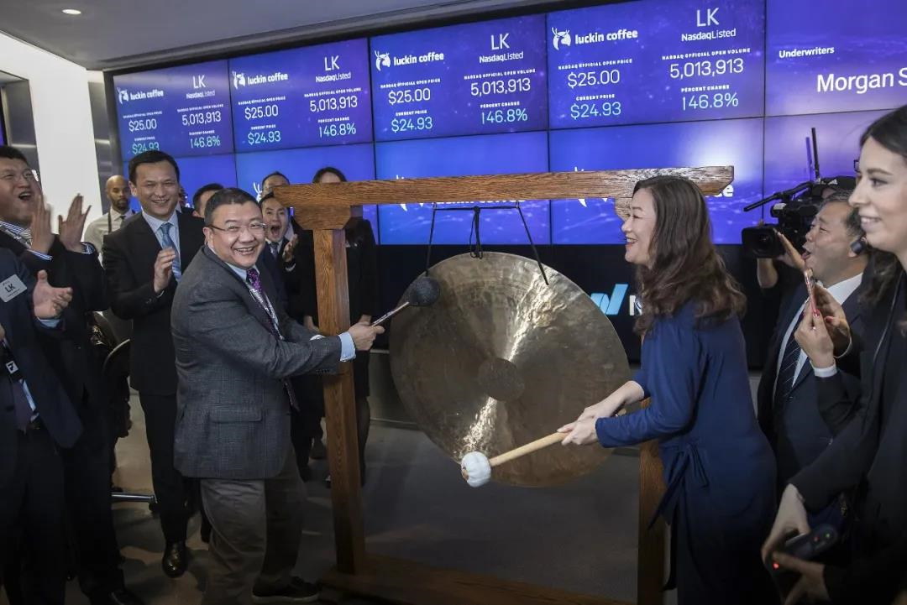
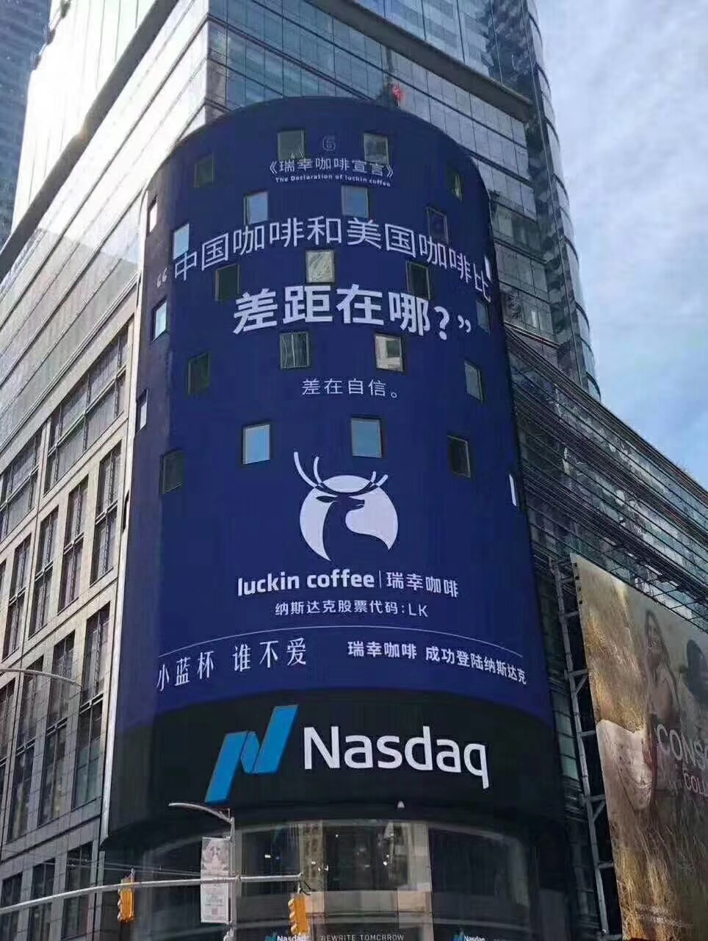

瑞幸咖啡：史上最快IPO记录、史上最快退市纪录
2017年10月营运，2019年全国4500家
门店，2020Q1 6500家门店
增发及可转
债募集9亿
IPO募集6.45亿
瑞幸驳斥做空报告
开始营业
201707
201710
201905
202001
？
Notes:
2019年1月11日是星巴克
进入中国市场20周年纪念日，瑞幸曾被
誉为星巴克最大竞争对手。

Slide 34
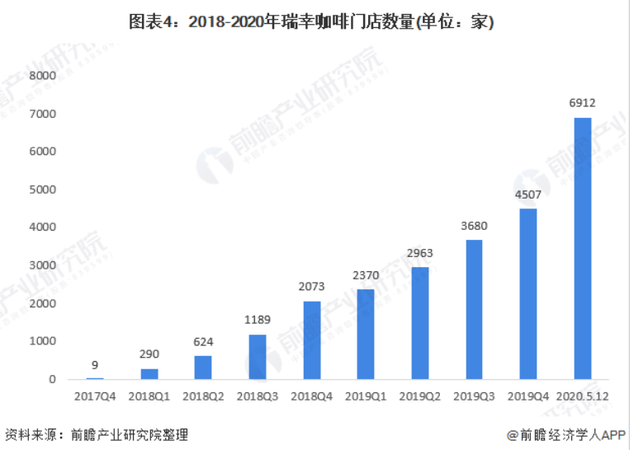
Notes:
美国数据机构Thinknum Alternative Data统计数据显示，截至5月12日，瑞幸咖啡今年二季度在中国的开店速度平均为每天10家，现门店总数已达到6912家。而瑞幸咖啡此前公布的数据显示，截至2019年底，瑞幸咖啡直营门店数为4507家，成为中国最大的咖啡连锁品牌。换言之，2020年以来，瑞幸咖啡共新开了2405家店。今年一季度，瑞幸咖啡的扩张保持在平均每天新开20家门店的速度。瑞幸咖啡第二季度的扩张速度虽然较第一季度有所放缓，但还是超过了去年同期的增长速度。
=30*4500
=13.5亿

Slide 35
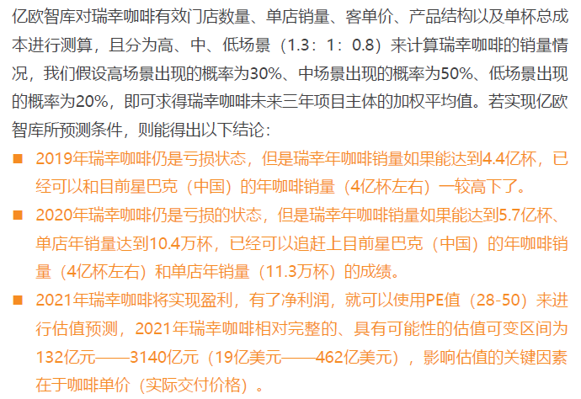
估值：科学、艺术、魔术、骗术？

Slide 36
瑞幸估值：科学、艺术、魔术、骗术？
序号 | 日期 | 融资 | 方式 | 投资方 | 估值
1 | 2017 | 6400万RMB | 个人借款 | 钱治亚、陈敏
2 |  | 9470万 | 无息贷款 | 陆正耀旗下公司
3 |  | 2.275亿 | 免息贷款 | 股东Star Grove
4 | 2018 | 1.476亿 | 无息贷款 | 陆正耀旗下公司
5 | 2018/5 | 3.5亿 | 融资租赁 | 光大融资租赁
6 | 2018/6 | 3亿 | 抵押贷款 | 西藏信托
7 | 2018/6 | 1.899亿USD | 天使轮 | 陆正耀旗下公司
8 | 2018/7/11 | 2亿USD | A轮 | 大钲资本、愉悦资本、GIC、君联资本 | 10亿USD
9 | 2018/12/12 | 2亿USD | B轮 | 大钲资本、愉悦资本、GIC、中金 | 22亿USD
10 | 2019/3 | 4500万 | 抵押贷款 | 中关村科技租赁
11 | 2019/3 | 6000万 | 担保贷款 | 浦发银行
12 | 2019/4 | 1.5亿USD | B+轮 | BlackRock | 29亿USD
13 | 2019/5 | 6.95亿USD | IPO | 承销商为瑞士信贷、摩根士丹利、中金公司和海通国 | 60亿USD
14 | 2020/1 | 9.8亿USD，每股42USD | 增发（1200股ADS+180万股股票+4亿可转债） |  | 市值最高120亿美元
Notes:
多轮增资：拉高估值，等待接盘侠！
误区1: 估值是找到真正的客观价值
¤ 真实情况 1.1: 所有估值都是有偏误，问题是有多大的偏误，高估还是低估。
¤ 真实情况 1.2: 估值偏误程度取决于谁来让你做估值，你从估值中得到的报酬是多少。（买方分析师vs买方分析师）
¨ Myth 2.: A good valuation provides a precise estimate of value
¤ Truth 2.1: There are no precise valuations.
¤ Truth 2.2: The payoff to valuation is greatest when valuation is least
precise.
¨ Myth 3: . The more quantitative a model, the better the valuation
¤ Truth 3.1: One_x0001_s understanding of a valuation model is inversely
proportional to the number of inputs required for the model.
¤ Truth 3.2: Simpler valuation models do much better than complex ones.
从巅峰时期的110亿美元市值，瑞幸咖啡目前市值仅剩3.6亿美元

Slide 37
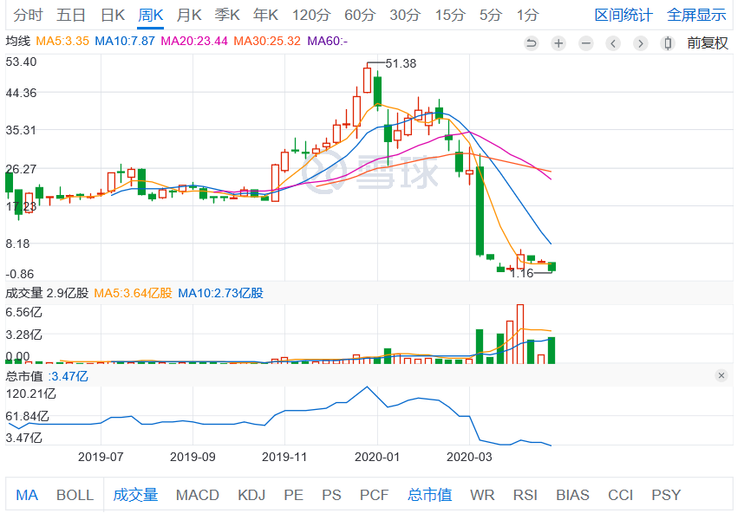
瑞幸咖啡(NASDAQ:LK）股价和市值)

Slide 38
瑞幸咖啡资产负债表？
 | 2018-12-31 | 2019-3-31 | 2019-3-31
资产 | RMB亿 | RMB亿 | USD亿
流动资产 | 24 | 18 | 2.66
非流动资产 | 11 | 11 | 1.67
总资产 | 35 | 29 | 4.32
负债
流动负债 | 8 | 8 | 1.26
非流动负债
长期借款 | 2 | 2 | 0.23
递延收入 | 1 | 1 | 0.12
非流动负债合计 | 4 | 2 | 0.34
负债合计 | 11 | 11 | 1.61
mezzanine equity（夹心融资：优先股、可转债） | 43 | 43 | 6.46
股本-天使1 | 7 | 7 | 1.1
股本-天使2 | 5 | 5 | 0.1
资本公积（股本溢价） | 1 | 1 | 0.1
未弥补亏损 | -32 | -38 | -5.69
股东权益合计 | -19 | -25 | -3.74
负债及股东权益合计 | 35 | 29 | 4.32
Notes:
融资6.95亿美元，估值60亿美元；

Slide 39
The New Venture Business Plan
The term business plan means different things to different people. Typically, it refers to one of three things:
(1) a strategic framework (or business model),
(2) an operational planning tool (a business roadmap),
and (3) an investor presentation (or business pitch).

Slide 40
The New Venture Business Plan
Why do we need to prepare a BP?
Presents the conclusions of the strategic planning exercise, i.e., the strategic planning comes first
Writing and circulating a business plan too early can be a costly mistake
Different than for an established business
uncertainty about assumptions
milestones and real options
used for raising capital

Slide 41
Overview of the Business Plan
Focus on the purposes and uses of the plan
Identify and support key assumptions
Highlight critical factors for success or failure
Delineate milestones so users can evaluate success
Include financial projections to test the plan, commit the entrepreneur, and facilitate negotiation

Slide 42
Outline of a Typical Business Plan
Executive Summary
Background and Purpose of Venture
Market Analysis
Products and Services
Development, Production, and Operations
Organization and Management
Ownership and Control
Financial Information

Slide 43
What Makes a Business Plan Convincing?
Demonstrate understanding of the technology, market, risks, and customer needs
Defensible assumptions that yield testable hypotheses
Credible evidence of irrevocable commitment
Evidence of reputation and certification
Signals the quality and capabilities of the team

Slide 44
Some Pitfalls to Avoid in the Business Plan
Failing to identify clearly the customer problem that the venture would address
Failing to identify clearly a narrow target market
Relying on a business model that does not make economic sense
Relying on a highly credentialed team that lacks the critical expertise the venture needs
Failing to recognize the threats and potential problems

Slide 45
3.投资人创业机会评估
Notes:
监管者视角：preparing for the assessment of the viability and sustainability of their business models by regulators and investors in light of the on-going challenging environment;
and
管理层视角：
analysing their business models to ensure they are maximising shareholder value.

Slide 46
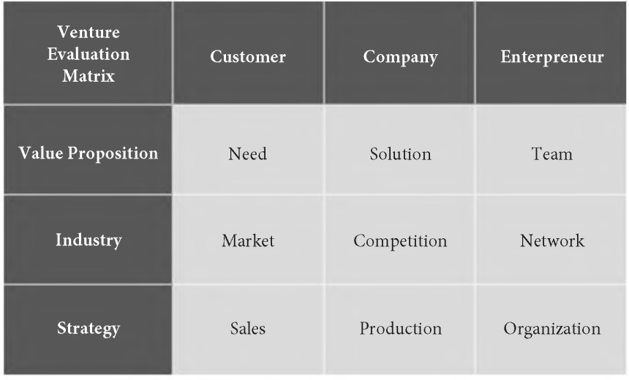
The Venture Evaluation Matrix (Horse Racing)
Notes:
a survey of venture capital firms conducted by Gompers, Gornall, Kaplan, and Strebulaev.When asked about their
most important criterion for selecting investments, 47% answered it was the team,
which corresponds to the Entrepreneur column. Another 13% answered product
and 10% business model, which corresponds to the Company column. Moreover,
8% answered market and 6% industry, which corresponds to the Customer column.
Of the remaining answers, the most important was investor fit (14%),Interestingly, only
1% considered valuation the most important criterion.
Need
1. What exactly is the customer need?
2. How strong is the need, and how well do customers recognize it?
3. How much is the customer able and willing to pay?
Working on a solution without first understanding whether it solves a real problem is a mistake made by many entrepreneurs(拿着锤子找钉子）. Understanding the need is re_x0002_lated to identifying the initial target customer. This is not trivial. To begin with, the
entrepreneur typically has a hypothesis about what the customer’s need might be, but
this hypothesis needs to be tested. The initial premise often turns out to be false. Too many entrepreneurs
focus on solving what th ey believe is the customer’s need. The risk is “forcing” a solu_x0002_tion to an alleged need before verifying the real need in the first place.
Henry Ford reportedly said: “If I had asked people what they wanted, they would have said faster horses"
solution to the customer’s need
1. Does the proposed solution solve the customer’s need?
2. How does the proposed solution compare to the alternatives?
3. To what extent can the innovation be protected?
Team
1. Do the founders have the required skills and experience?
2. Do the founders have sufficient motivation and commitment?
3. Is the founder team complementary and cohesive?
Market
1. How large is the target market?
2. How fast will the target market grow?
3. How will the customer adopt?
Competition
1. Who are the current and future competitors?
2. What is the nature of competition?
3. How can the venture differentiate itself?
Network
1. What is the reputation of the founder team?
2. What networks does the team have access to?
3. How does the team forge and maintain new relationships?
Sales
1. How does the venture reach its customers?
2. What is the distribution strategy?
3. What are the revenue model and pricing strategy?
Production
1. What is the development strategy?
2. What is the scope of activities, and what partnerships are necessary?
3. How efficient are operations?
Organization
1. How will the founder team expand and evolve?
2. What is the governance structure?
3. What is the talent strategy?

Slide 47
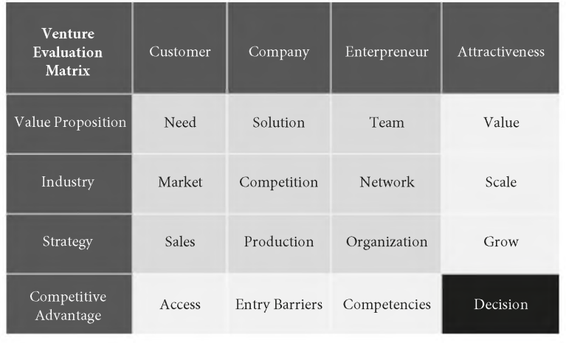
Summary
Notes:
7.3 fundementals of entrepreneurial finance

Slide 48
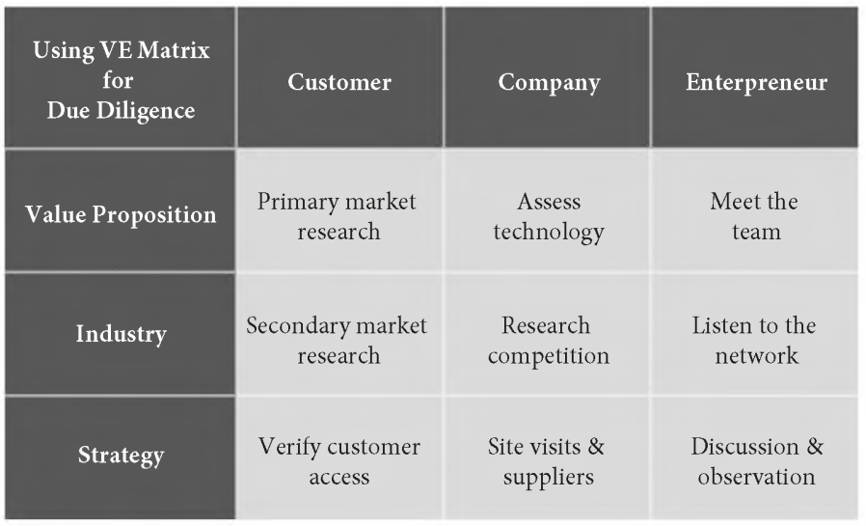
Due diligence with the Venture Evaluation Matrix.
Notes:
7.3 fundementals of entrepreneurial finance
The way to evaluate the production strategy is similar to that of the sales strategy. For later-stage companies,
it is also possible to benchmark a venture against its competitors
In the context of group decisions, such as angel groups or venture capital in_x0002_vestment committees, there is another use of the VE Matrix: to objectively com_x0002_municate preferences and investment logics within the group.

Slide 49
The MATCH Tool
蔚能换电业务评估

Slide 50
Using the Venture Evaluation Matrix for writing a business plan
Section 1 Executive Summary 2 Customer Need 3 Product/Service 4 Market Analysis 5 Competition Analysis 6 Marketing and Sales Sales 7 Development and Operations 8 Business Model 9 Management Team 10 Financial Projections | Venture Evaluation Matrix Cells Summary of cells, rows, and columns Need Solution Market Competition Sales Production, Organization Sales,Production Team, Network, Organization Finance
Notes:
7.3 fundementals of entrepreneurial finance

